Slide 1
Aid Escalating Internet Coverage
Final Evaluation -3
Team: Divergents
Submitted By:
Yogita Verma (PGDBD202204018)
Tavleen Bajwa (PGDBD202204017)

Slide 2



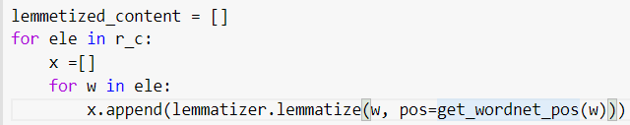
Pre-Processing
Replacing ‘?’ in data with Nan values
2.
Dropping Frame based column
Textual Data Pre - processing PartI
Textual Data Pre processing - Part I
1.
3.

Slide 3
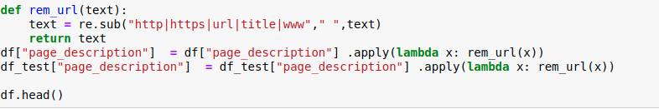
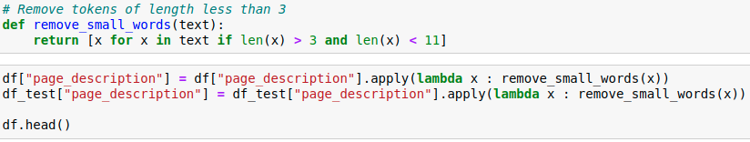
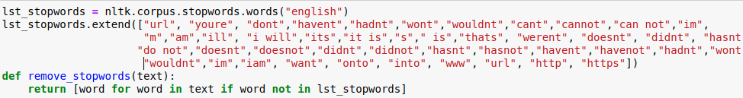

NLP Preprocessing of Page description after Eval 2
Removed url/http/
title etc
Removed tokens <3 and > 11 letters
Manual Text Clean Up
Extraction of Unique Words

Slide 4
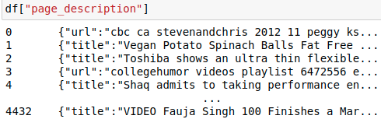
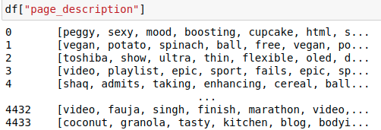
Text Before and After Preprocessing
Before
After

Slide 5
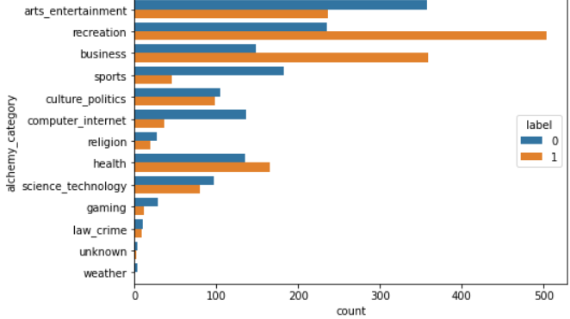
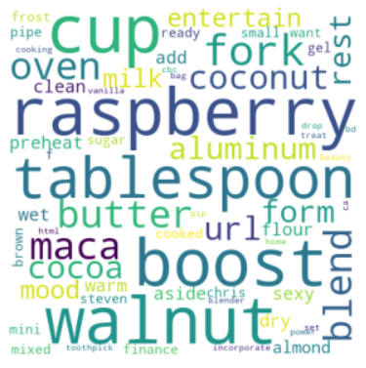
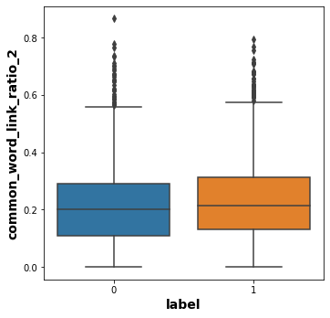
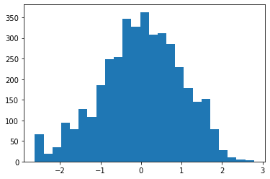
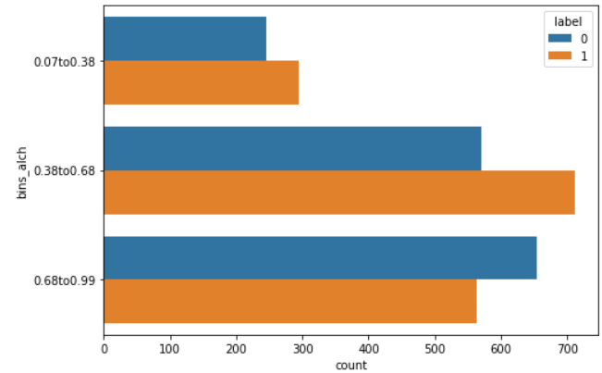
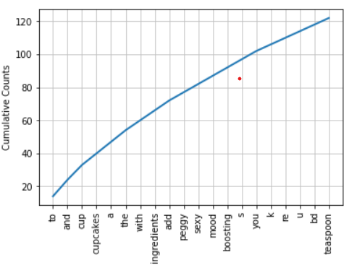
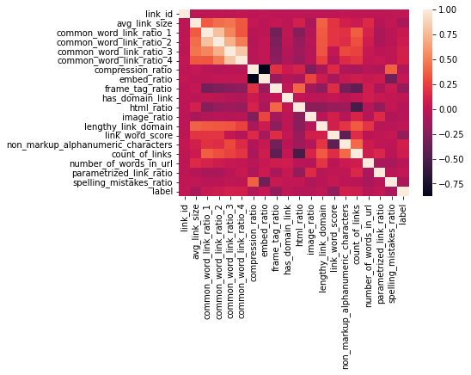
Exploratory Data Analysis
Categorical Columns
Continuous Columns
Correlation Matrix, Box Plots, Histograms
Bar Plot, Word Cloud Visualization, Frequency Distribution analysis of words

Slide 6
EMBEDDING AND VECTORIZATION
01
Hyperparameter tuning -
sublinear_tf = True
analyzer = 'word'
ngram_range = (1, 2)
min_df = 5
max_df = 0.95
norm = 'l2'
max_features = 8600
TF-IDF VECTORIZATION
02
Hyperparameter tuning -
vector_size=5000
window=5
min_count=2
Word2Vec Vectorization
03
Hyperparameter Tuning
dm=0 and dm=1(alternatively)
vector_size=8000
negative=5
hs=0
min_count=2
sample = 0
alpha=0.025
Doc2Vec Vectorization
Finally we used Doc2Vec for Vectorization

Slide 7
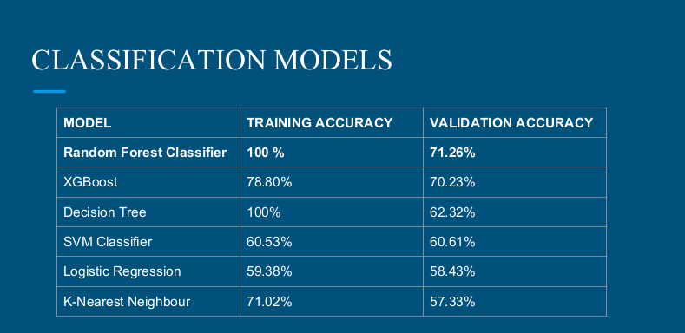
Previous Models (Eval2) without Hyperparameter Tuning

Slide 8
Classification Models after Hyperparameter Tuning using GridSearchCV & Stratified K-fold
Logistic Regression
Training Accuracy
Testing Accuracy
Kaggle Sumission Accuracy
max_iter=2000
multi_class= 'multinomial'
penalty= 'l1'
solver= 'saga'
warm_start = True
0.882125603
0.7770270270
0.79768
XGBoost
gamma=5,eta=0.2,alpha=7,grow_policy="depthwise",learning_rate=0.05,subsample=0.5,max_depth=15,n_estimators=15, min_child_weight=3, predictor='auto',sampling_method='uniform',tree_method='hist'
Training Accuracy
Testing Accuracy
Kaggle Submission
Accuracy
0.8679549114
0.83033033033
0.80898

Slide 9
Training Accuracy
Testing Accuracy
Kaggle Submission Accuracy
Voting Classifier
estimators=[('lr', model_1), ('xgb', model_2), ('rf', model_3)], voting='hard', weights = [1,1,2]
0.996135
0.80405405
0.81849
Adaboost Classifier
Training Accuracy
Testing Accuracy
Kaggle Submission Accuracy
n_estimators=150,learning_rate=0.01,algorithm="SAMME"
0.8791781
0.792792
0.8123

Slide 10
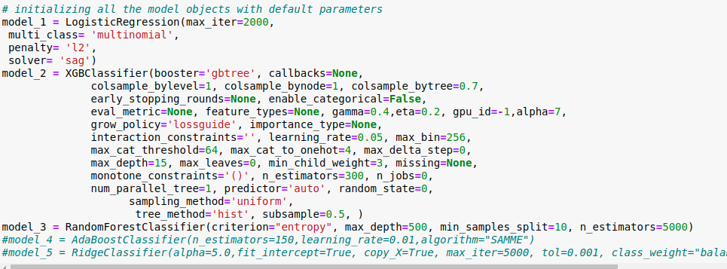
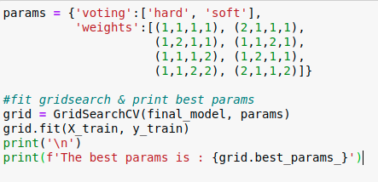
Hyperparameters for Voting Classifier (Final Model)
Best params for Voting Classifier came out to be voting = “Hard”, weights = (1,1,2,1), Maximum weight to Random Forest Model (which was hyperparameter tuned separately)

Slide 11
Teammates Contribution
Yogita Verma
Preprocessing & EDA of Categorical columns
NLP Text Processing (Eval 2)
Vectorization & Embedding (Doc2vec, Word2vec)
Hyperparameter tuning (AdaBoost Classifier, Logistic Regression Classifier, XGBoost Classifier)
Tavleen Bajwa
Preprocessing & EDA of Continuous columns
NLP Text Preprocessing (Eval 3)
Vectorization & Embedding (TFIDF)
Hyperparameter tuning (Voting Classifier, Random Forest Classifier, Ridge Classifier)

